Slide 1
Technology Review
Collisions in Washington State
By: Fei Wang, Geoff , Salik Warsi
Notes:
LIbby

Slide 2
Collisions in Washington State User Stories
Where do accidents occur in Seattle?
Is there a relationship between weather and driving?
Do different types of accidents happen in different neighborhoods with different levels of crime (measured by 911 calls)?
Have the number of accidents changed over time? Can we see the change in Seattle speed limits in the Seattle collision data?
If the user has similar data for another city, they can use the methods we create on their own data.
Notes:
LIbby

Slide 3
Collisions in Washington State Background
Where do accidents occur in Seattle?
Is there a relationship between weather and driving?
Do different types of accidents happen in different neighborhoods with different levels of crime (measured by 911 calls)?
Have the number of accidents changed over time? Can we see the change in Seattle speed limits in the Seattle collision data?
If the user has similar data for another city, they can use the methods we create on their own data.
Maps necessary to understand these questions!!!
Notes:
Libby

Slide 4
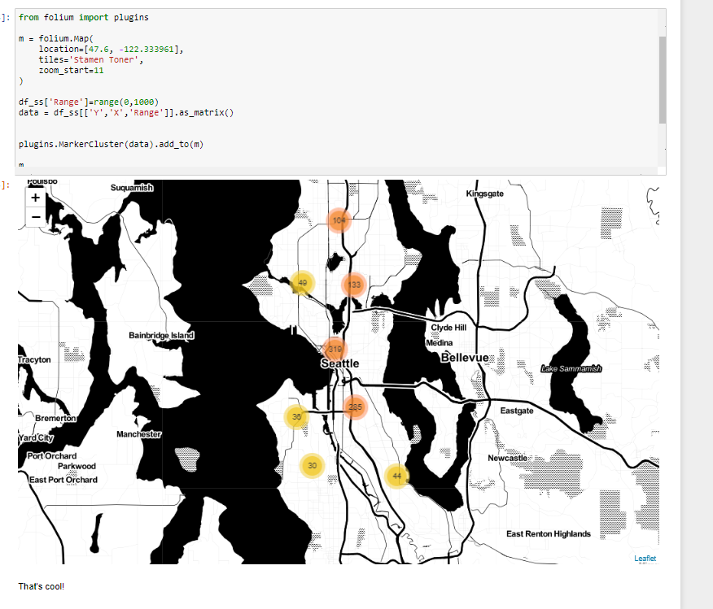
Collisions in Washington State Using Folium
Tried to plot location of 1000 “sideswipe” collisions
Our data has prelabeled lat/lon. Little clean-up required
Folium makes it extremely easy to plot & cluster these collisions with relatively little code
Lots of flexibility on map appearance and 3rd party plug-ins
Notes:
Geoff

Slide 5
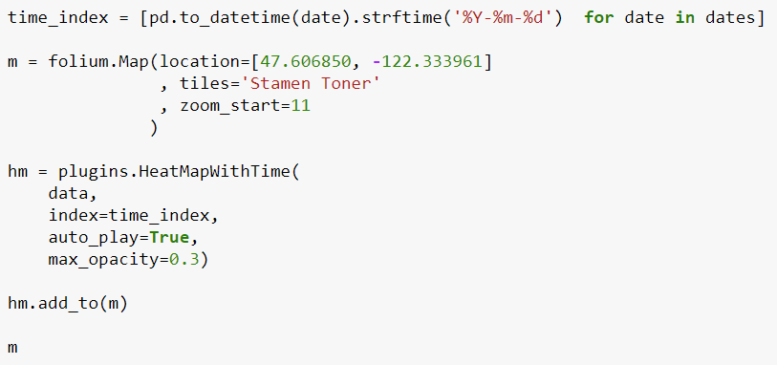
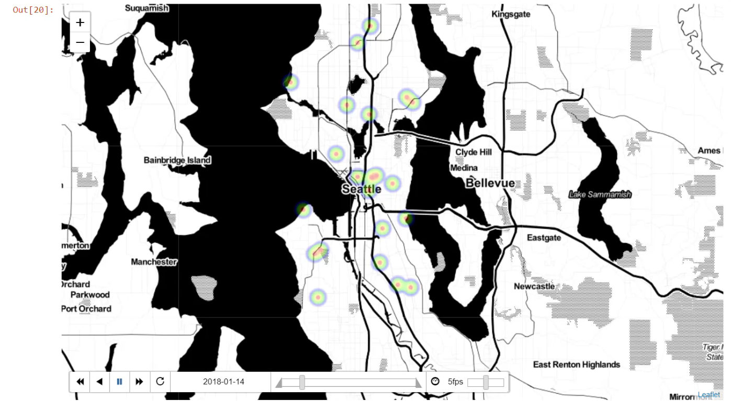
Collisions in Washington State Using Folium
Interactive Plotting
Many of our use cases requires the ability to create visualizations with temporal data
Folium’s HeatMapWithTime Plug-in makes it very easy to visualize the cluster of collisions over time

Slide 6
Collisions in Washington State Using Folium
Appeal
Easy to quickly plot & cluster any lat/lon data
Seems to work with shape files or choropeth mapping
Lots of flexibility on map appearance and 3rd party plug-ins
Builds on top of Leaflet, so includes many of it’s capabilities
Less mature but more active project maintenance recently than Dash (20 closed issues in the last month; 730 forks; 3,000 stars)
Drawbacks
Not as easy to make interactive dashboards as plotly? (But seems good enough for our use cases)
Adding >1000 markers seems slow (there may be a plugin to fix this?)
Some example codes from the documentation site is outdated, maybe due to rapid updates recently?
module 'folium' has no attribute 'raster_layers’
Seems some functions of branca are degenerated (and there is no doc for branca)
Notes:
Fei

Slide 7
Collisions in Washington State Using Dash
Appeal
Easy to draw interactive charts using plotly
Great documentation for supported charts
Plotly provides capabilities for maps using MapBox
Active Github (6 closed issues in the last month; 450 forks; 4,800 stars)
Drawbacks
Only works with plotly graphs. Other libraries like matplotlib not supported.
To use maps, a MapBox account is required
Custom shape files (such as Seattle neighbourhoods) aren’t supported in maps
Notes:
Fei

Slide 8
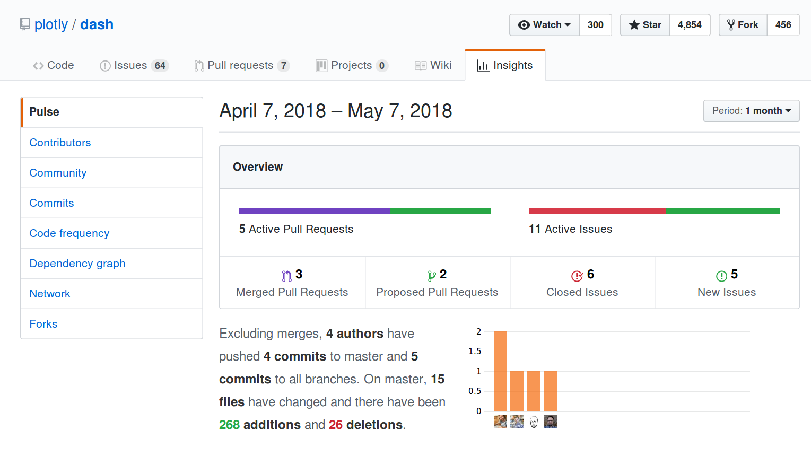
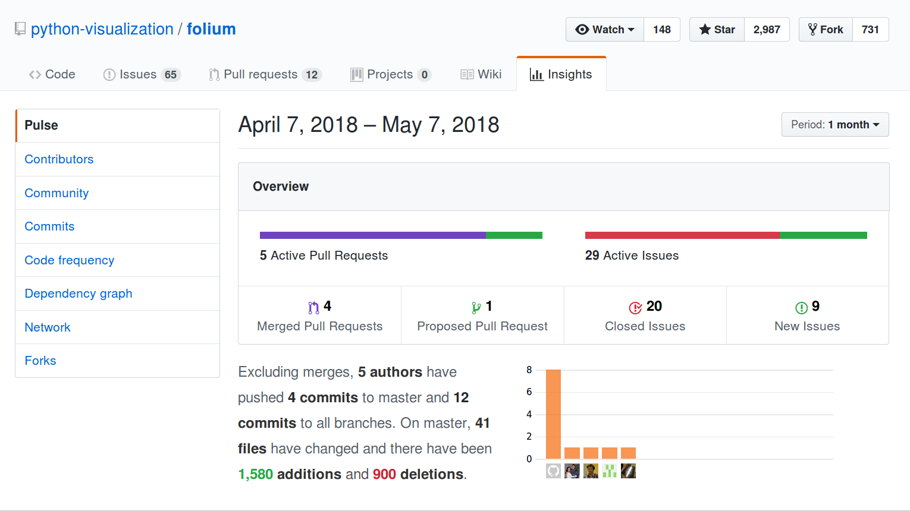
Collisions in Washington State Project Maintenance
Notes:
Salik

Slide 9
Other Packages Considered
Django Web Widgets
Django is a framework for creating webpages
The examples all call the Google Maps API and do not appear to have layering functionality
Bokeh
Mapping types: layers over google maps, tile maps, GeoJSON
Support for mapping is limited
Notes:
Libby

